Slide 1

How has encryption evolved and can it survive in the age of quantum computing?
Jack

Slide 2

Reasons Behind My EPQ
NEW SKILLS
UNIVERSITY
PERSONAL INTEREST
COURSE MODULES
INSPIRED BY A BOOK
PREVIOUS INTEREST

Slide 3

Target Aims and Objectives
Investigate how quantum computers function.
Explain how quantum computers are superior to modern computers.
Analyse the threat quantum computers pose to existing cryptographic infrastructure.
Examine how the threat quantum computers pose can be mitigated.
Explore the evolution of cryptography.

Slide 4


INTRODUCTION
What is cryptography/
encryption?
Why is encryption important?
Could quantum computing render encryption obsolete?

Slide 5
How has encryption evolved and can it survive in the age of quantum computing?
A Brief History of Cryptography
Quantum Mechanics and the Quantum Computer
What threat does quantum computing pose and how can it be mitigated?

Slide 6

A Brief history of Cryptography
Ancient Cryptography
Scytale
Caesar Cipher
Vigenère Cipher
Cryptography in the World Wars
Enigma
One Time Pad
Modern Cryptography
DES
AES
RSA
BACK

Slide 7
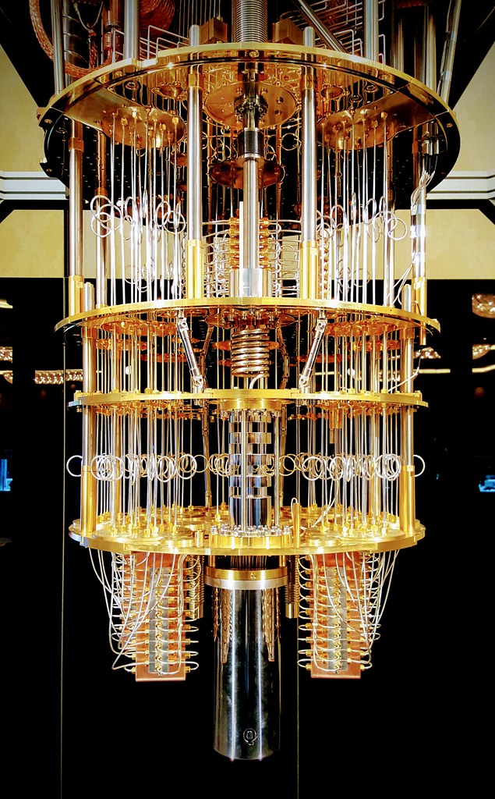
Quantum Mechanics and the quantum computer
What is a quantum computer?
What are the different types of quantum computer?
Quantum Annealer
Analogue Quantum Computer
Universal Quantum Computer
BACK

Slide 8

What threat does quantum computing pose and how can it be mitigated?
The threat quantum computers pose
Grover’s Algorithm
Shor’s Algorithm
Defending against quantum attacks
Increasing key sizes
Quantum intractable encryption
Quantum key distribution

Slide 9

CONCLUSION
Encryption has reached the point where it is almost impossible to break.
Quantum computers have started to develop from concepts into powerful machines capable of breaking many of the ciphers we use today.
However, there are ways we can defend against the threat
Increased key sizes
Quantum intractable encryption
Quantum key distribution

Slide 10

Evaluating the project
Skills developed
What was successful?
Lessons learned and what I’d do differently next time

Slide 11

Skills Developed
Independent working
Time management
ICT skills
Communication skills
Referencing skills
Planning and organisational skills
BACK

Slide 12

What was successful?
Time management
Planning
Structure
Making complex topics accessible
Title change
Engagement
BACK

Slide 13

Lessons Learned and what I’d do differently next time…
Problems finding free research material.
Difficulties with the word limit.
More specific title.
Don’t choose too broad a topic.
Shorter plan.
Manage your time.

Slide 14


Any QUESTIONS?

